Slide 1

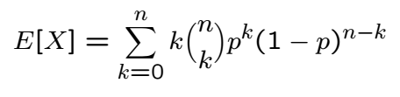
Binomial Mean and Variance
Not easy to calculate using definition of expectation

Slide 2
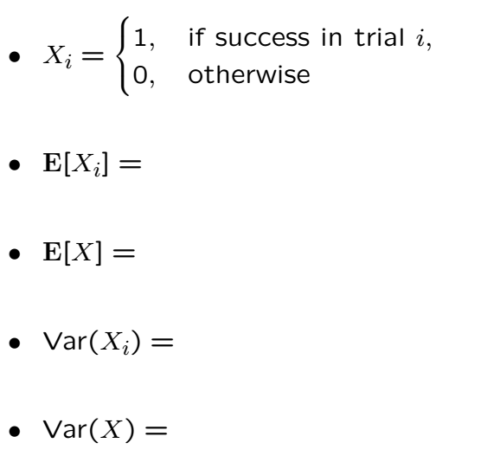
Binomial Mean and Variance

Slide 3
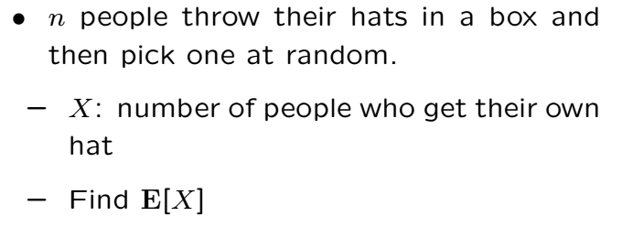
The Hat Problem

Slide 4
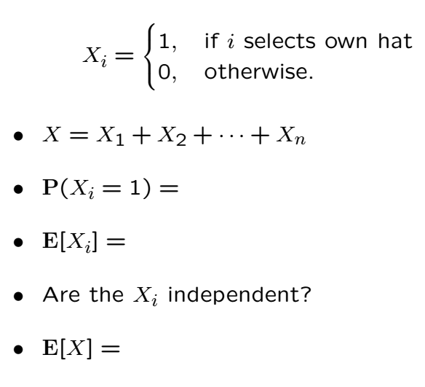
The Hat Problem Cont’

Slide 5


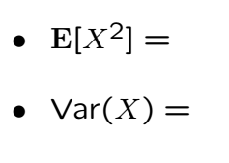
Variance in the Hat Problem

Slide 7
Acknowledgements and Citations
Parts of these slides are adapted from the following resources:
Power Point Lecture Slides for the Textbook http://bcs.wiley.com/hebcs/Books?action=index&bcsId=8676&itemId=1118324560
John Tsitsiklis. 6.041 Probabilistic Systems Analysis and Applied Probability, Fall 2010. (Massachusetts Institute of Technology: MIT OpenCourseWare),http://ocw.mit.edu (Accessed 13 Apr, 2015). License: Creative Commons BY-NC-SA

